Slide 1
Part of speech tagging
With hidden markov model

Slide 2
Table of content
Introduction
Problem Definition
Hidden Markov Model
Forward
Backward
Gamma
Viterbi
Baum-Welch
Solve POS tagging (easy way)
Solve POS tagging (Hard way)
Results Explanation
Conclusion

Slide 3
introduction
Why Part of Speech tagging is important?
Number of digital documents has grown exponentially
Text Mining and Text Classification has become important
POS tagging helps us to solve these and some other NLP problems
Where else do we use part of speech tagging?
Text description
Language recognition
Comment mining and social media analysis
Etc.

Slide 4
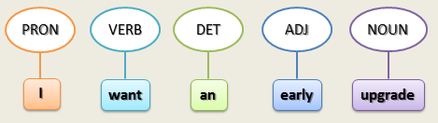
Problem Definition
What is POS tagging?
It is the task of tagging every element of the text (word, number, sign, etc.) with a grammatical role (‘NOUN’ , ‘ADJ’, ‘Number’, ‘dot’, etc.)

Slide 5
Problem Definition
How do we solve this problem?
Stochastic POS tagger (Statistical)
Hidden Markov Model
Deep Neural Network
SVM
Etc.
Rule-based tagger
Regular expressions + Lexical rules
Hybrid tagger
Stochastic tagger + Rule-based tagger

Slide 6
Hidden markov model
HMM is statistical Markov Model used for modeling pseudo-randomly changing systems.
In HMM we see the time as series of snapshots
Markov assumption
We assume states space and observation space will not change
We assume current state depends only on a limited number of events occurred before
HMM is a general form of MM which we only have observations

Slide 7
Hidden markov model variables
HMM : {N,M,A,B,}
N: state space
M: observation space
A: Transition Probability (probability of going from state si to sj)
B: Emission Probability (probability of seeing observation oj in state si)
π: Beginning Probability (probability of starting from state si)
O: {o1, o2, … , oT}
Observation at time t is saved in variable ot

Slide 8
Hidden markov Model Algorithms
What is the probability that a model generated a sequence of observations? (Forward-Backward algorithm)
What sequence of states best explains a sequence of observation? (Viterbi algorithm)
Given a set of observation sequences, how do we learn the model probabilities that would generate them? (Baum-Welch)

Slide 9
Hidden Markov model advantages
Linear Time Complexity
Great accuracy (97%)
Vectorize implementation
Flexibility (can be altered to a hybrid model easily)
No hyper parameters (unlike neural networks)
Simple Operations (no division or matrix inverses)

Slide 10






Forward ($α$)
Forward: the probability of the partial observation sequence o1, o2, …, ot and ending up in state si at time t given the model λ.
We will solve this inductively
Initial step
Inductive step
Termination

Slide 11
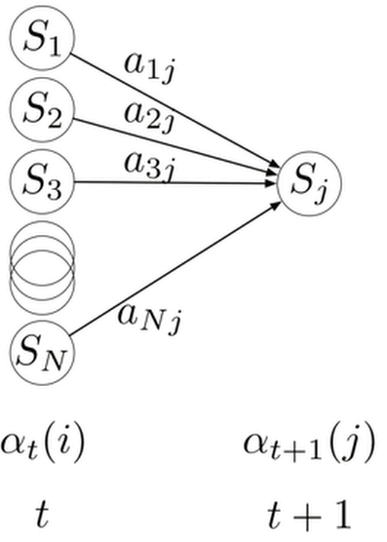
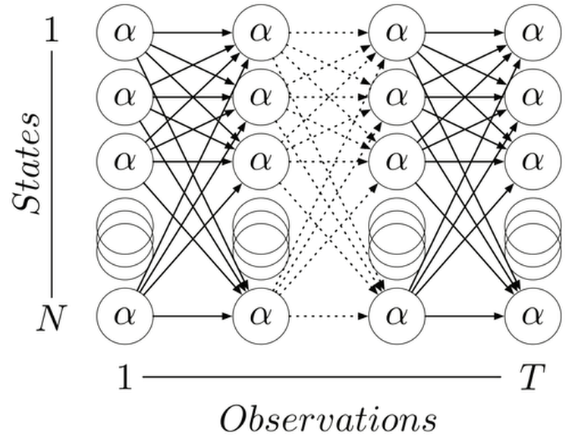
Forward (figure)

Slide 12



Backward ($β$)
Backward: the probability of the partial observation sequence ot+1, …,oT and given state si at time t and the model λ.
We will do this inductively
Initial step
Inductive step

Slide 13
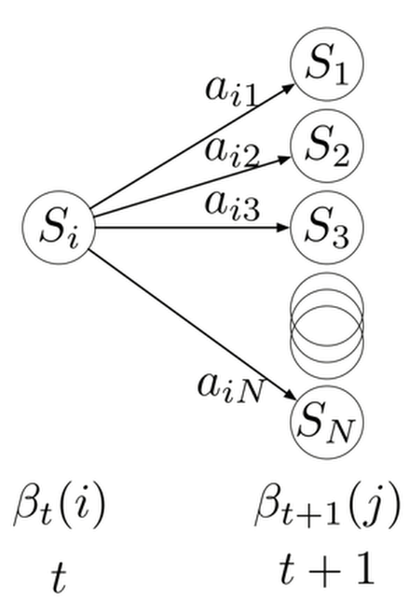
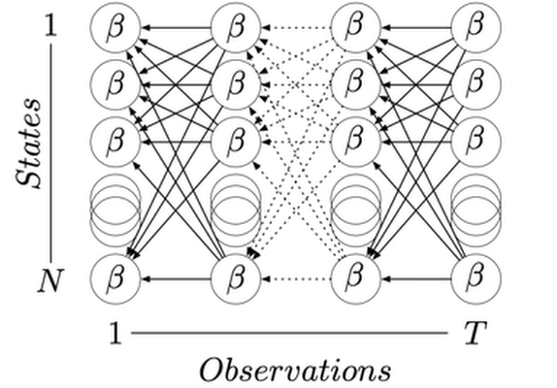
Backward (figure)

Slide 14


Gamma
Forward is the probability of being at state Si at time t given observations that comes before
Backward is the probability of being at state Si at time t given observations that comes after
Gamma is the probability of being at state Si at time t given all observation that comes before and after

Slide 15
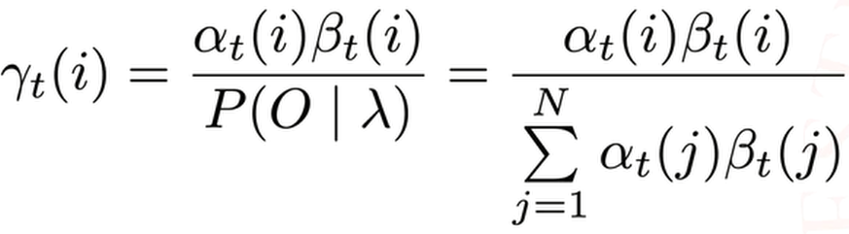
Gamma
We can compute gamma using alpha and beta:

Slide 16

Viterbi
Delta t (i): The highest probability along a single path at time t and seeing O1, …, Ot and ending up in state Si.

Slide 17
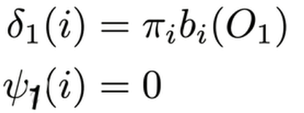
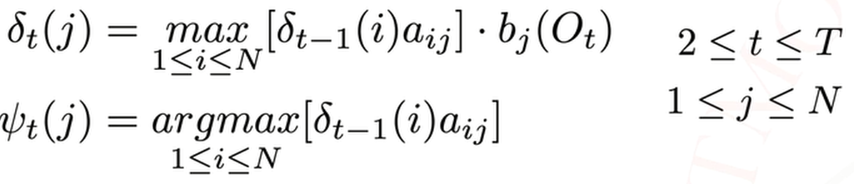
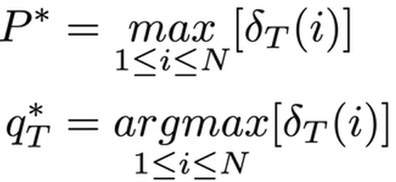

Viterbi
We do this inductively
Initial step
Inductive step
Termination
Path backtracking

Slide 18
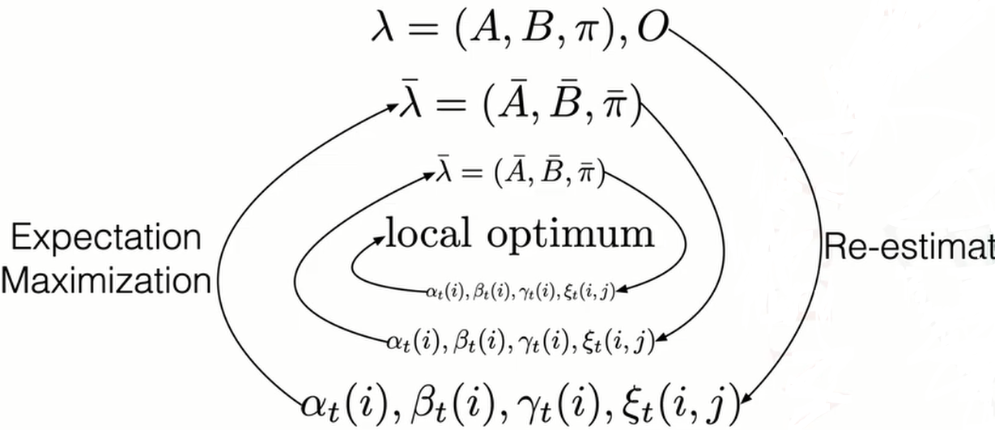
Baum-welch
Baum-welch is an Expectation Maximization algorithm which uses gradient descent method for finding the locally optimum model given the observations

Slide 19

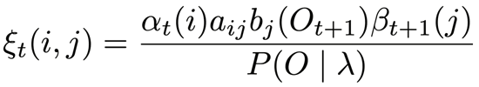
Baum-welch
We need a new mathematical tool for this algorithm:
The probability of transitioning from Si to Sj at time t
We can compute εt (i, j) using alpha and beta terms:

Slide 20
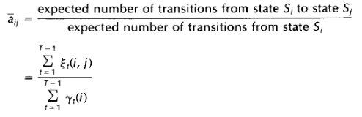
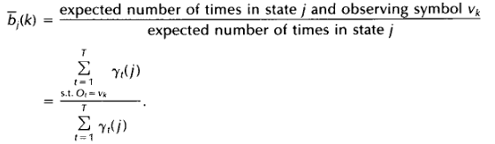
Baum-Welch

Slide 21
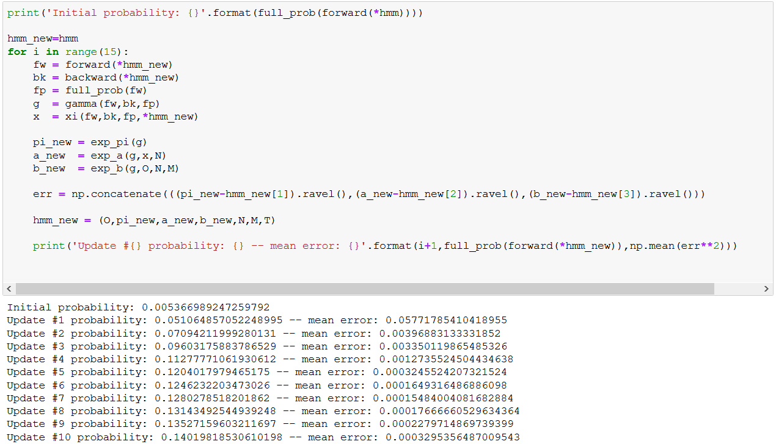
Baum-welch

Slide 22
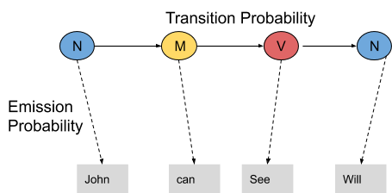
Solve POS tagging (easy way)
HMM for POS tagging
Observations: the words (like ‘john’, ’is’, etc.)
States: grammatical roles (like ‘NOUN’, ‘VERB’, etc.)
Transition probabilities: probability of a role like ‘VERB’ follow another role like a ‘NOUN’
Emission Probabilities: probability of a role like ‘NOUN’ to be the word ‘John’ for example

Slide 23
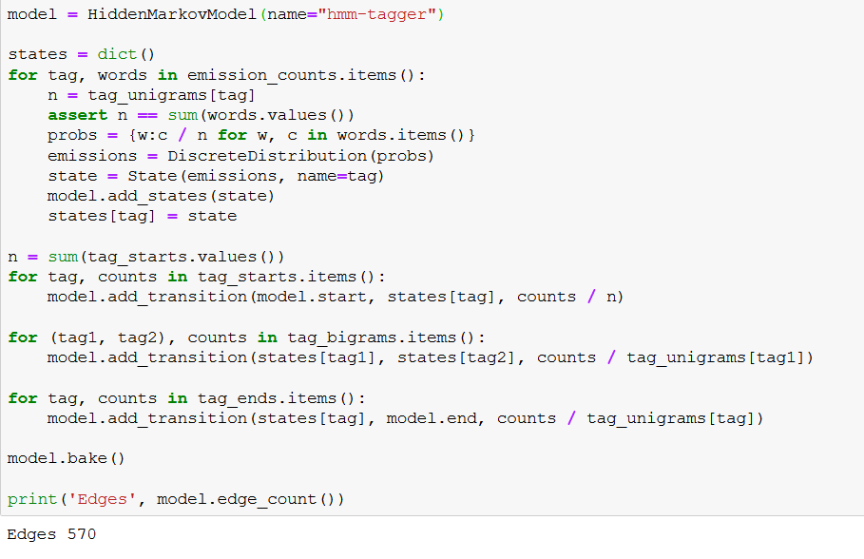
Solve POS tagging (easy way)

Slide 24
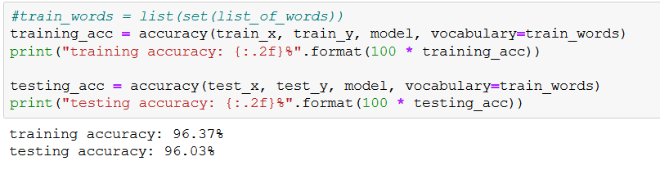
Solve POS tagging (easy way)
The accuracy:

Slide 25
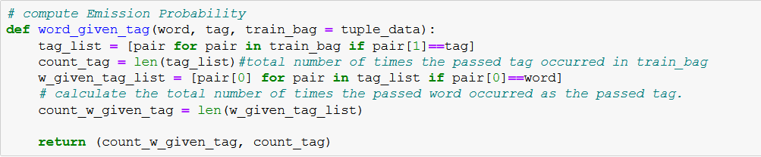
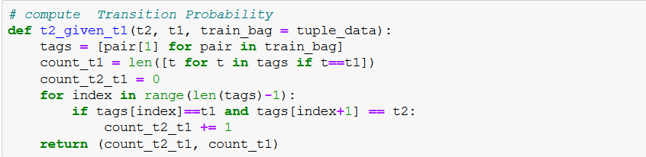
Solve POS tagging (Hard way)

Slide 26
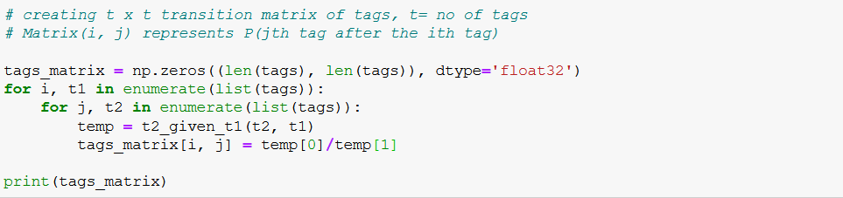
Solve POS tagging (Hard way)

Slide 27
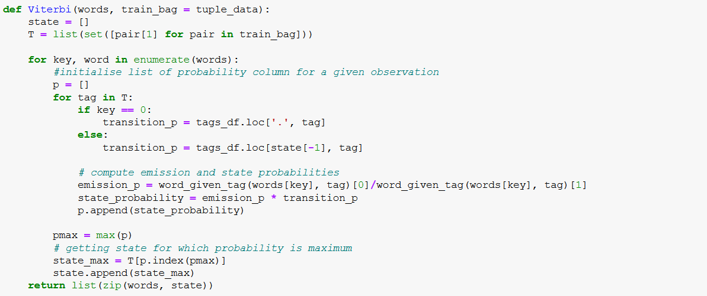
Solve POS tagging (Hard way)

Slide 28
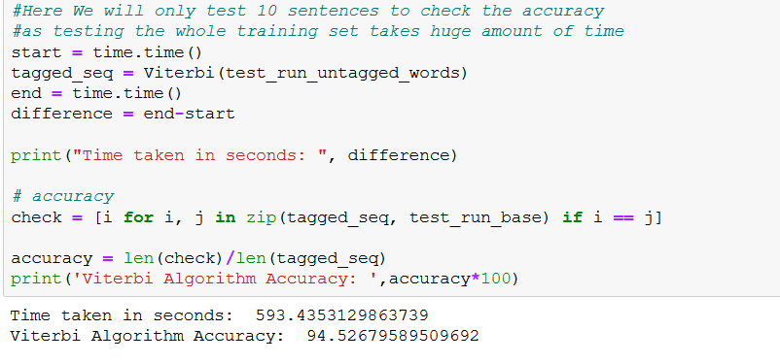
Solve POS tagging (Hard way)

Slide 29
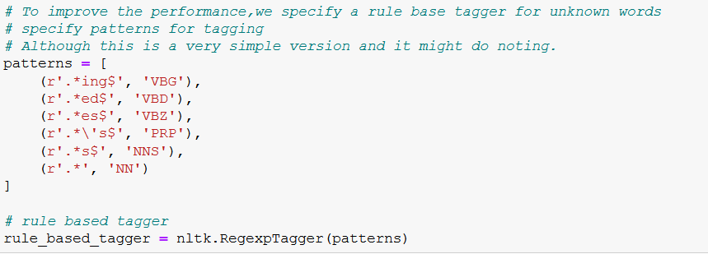
Solve POS tagging (Hard way)

Slide 30
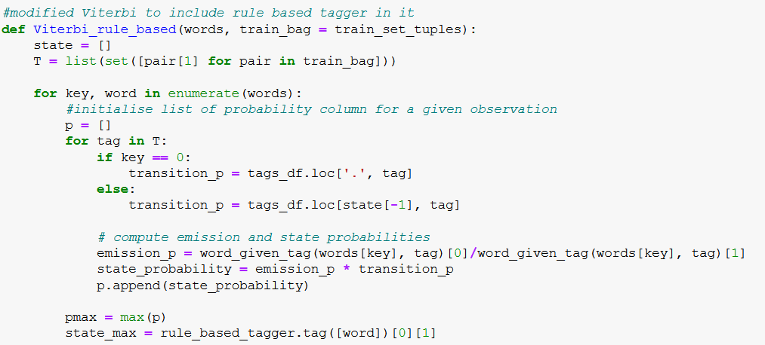
Solve POS tagging (Hard way)

Slide 31
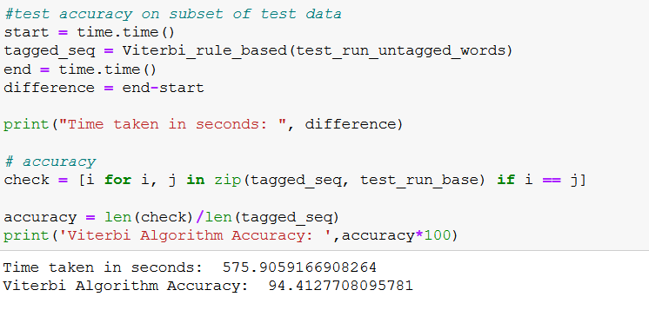
Solve POS tagging (Hard way)

Slide 32
Results Explanation
Why the result from the POS tagging with the Pomegranate library was 1% less than expected?
Our corpus has less sentences than the ones used in the articles
Our corpus has less Tags than the ones used in the articles
We did not use HMM smoothing
We did not use sparse matrix smoothing

Slide 33
Results Explanation
Why the result from the POS tagging with our code was 2.6% less than expected?
Same reasons that we said in previous slide
We did not optimize the model with Baum-Welch
Why the algorithm took a lot of time?
We did not build the observation matrix (so it has to read the whole corpus to tag a word; this method takes much less memory)
Why the hybrid model was faster?
Because we did not read the corpus for the unknown word and use regular expressions to solve them

Slide 34
conclusion
In this project we solved POS tagging with HMM in three ways and we understood that:
HMM is a very accurate and time efficient way to solve problems like this (pseudo-randomly changing systems)
HMM can be Vectorized and it has a flexible foundation for optimizations of our own
HMM has a lot of applications and it is very well studied
Hybrid models works better and faster if done properly
Smoothing is a good way to improve HMMs performance

Slide 35
The end.
Contact me: hamid.nemati@ec.iut.ac.ir
Contact Instructor: hashemim@iut.ac.ir
Supervising Senior Engineer: Zahra gholamalian

